Slide 1
SEN152 – Topic 4: Software maintenance and documentation; quality management; and Artificial Intelligence (AI) and software development
4.1 Software maintenance and documentation
4.2 Software quality management
4.3 Quality management framework
4.4 Artificial Intelligence (AI) and software development

Slide 2
Module Outcomes
Demonstrate insight in the history of software development.
Demonstrate an understanding of different options for software development life cycles related to software design and development, and key terms, facts, principles and rules of software development.
Apply methods, tools and modelling techniques commonly employed during the various phases of software development.
Demonstrate an understanding of the importance of software maintenance and documentation.
Identify modern software development and management platforms, tools, and services, and outline the nature of the support provided.
Demonstrate an understanding of the notion of quality in software and how a Quality Management System can provide the required organisational framework.

Slide 3
4.1 Software maintenance and documentation
Software maintenance is a crucial phase in SDLC.
The process of modifying and updating software applications after delivery to correct faults, improve performance, or adapt to a changed environment.
Maintenance ensures software continues to perform effectively and meet user needs long after its initial deployment.

Slide 4
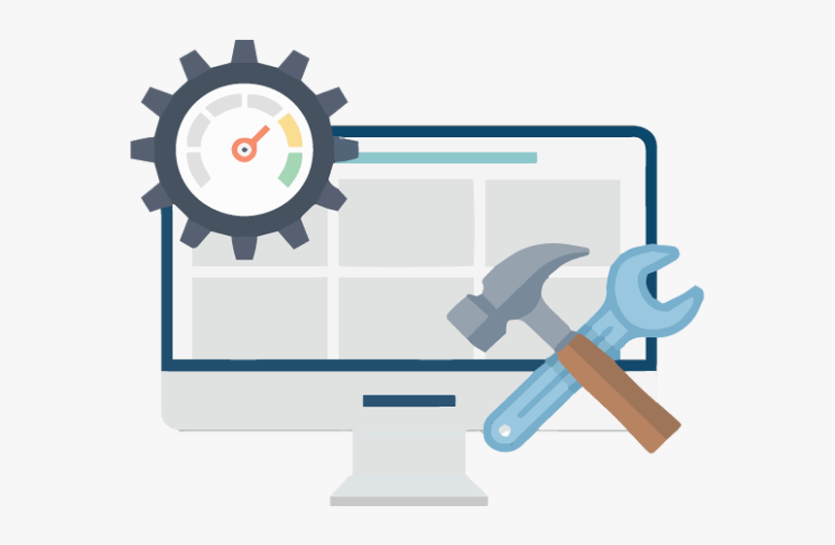
4.1 Software maintenance and documentation
4 primary types of software maintenance:
Corrective
Adaptive
Perfective
Preventive

Slide 5

4.1 Software maintenance and documentation
Software maintenance challenges:
These include understanding legacy code, dealing with outdated documentation, managing dependencies, and ensuring compatibility with new technologies.

Slide 6
4.1 Software maintenance and documentation
Systems support comprises 4 ongoing activities:
Programme maintenance: All systems contain errors or defects that may not have been detected during the testing phase.
System recovery: In the event of system failure or data loss, system recovery involves restoring the system and its associated data to full functionality.
Technical support: Even after training, users may require further assistance.
System enhancement: As business needs evolve and technology advances, systems must be updated.

Slide 7
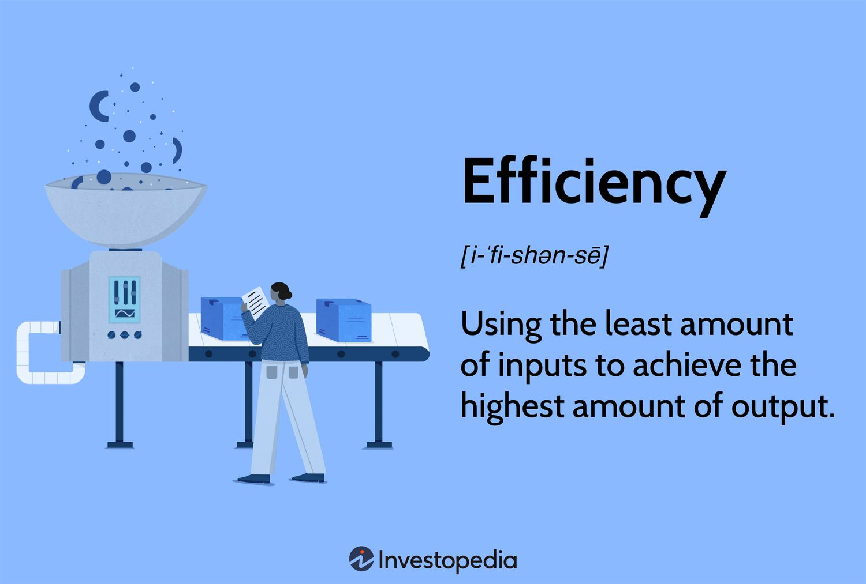
4.1 Software maintenance and documentation
The key objectives of system maintenance are centred around ensuring the continued effectiveness and reliability of software systems.
It is essential that all maintenance tasks are completed efficiently.

Slide 8
4.1 Software maintenance and documentation
The development team must assist the customer with the conversion process and provide end-user training.
Another essential task is supplying the customer with system documentation (user manuals or other online sources) that will guide users in operating the new system.
System documentation is often prepared by a systems analyst who specialises in writing user manuals and training guides.

Slide 9
4.1 Software maintenance and documentation
Documentation plays an important role in effective software maintenance.
It provides detailed information about the software’s design, codebase, functionalities, and dependencies.
There are several types of software documentation, including user manuals, system documentation, code documentation, and technical references.

Slide 10
4.1 Software maintenance and documentation
Effective documentation should be clear, concise, up-to-date, and accessible.
Many organisations make use of online help centres to provide support to end-users.
Typical features include "Getting Started" guides, Frequently Asked Questions (FAQs), troubleshooting steps, and community forums.
Organisations also include video tutorials to provide users with a more engaging and comprehensive learning experience, enhanced with multimedia.

Slide 11
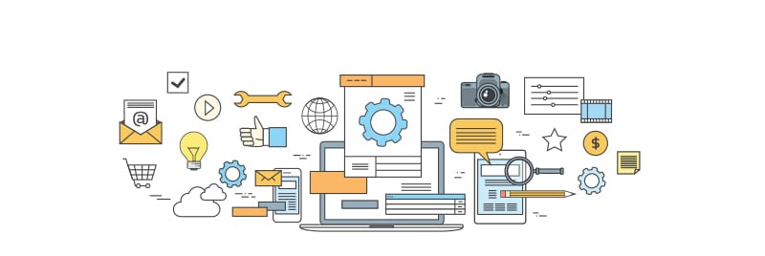
4.1 Software maintenance and documentation
Modern tools and platforms can greatly assist in both software maintenance and documentation.

Slide 12

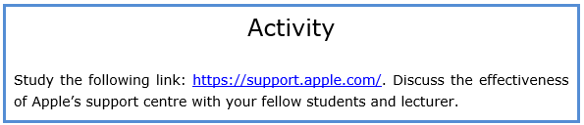
4.1 Software maintenance and documentation
https://support.apple.com/

Slide 13
4.2 Software quality management
SQM promotes standardisation, proper documentation, and adherence to coding best practices, which in turn supports maintainability and scalability.
Through quality audits, reviews, and continuous testing, SQM ensures that the final product is not only functional but also secure, efficient, and user-friendly.
Organisations choose to adopt Agile for a variety of reasons, one of the most significant being its impact on software quality.

Slide 14
4.2 Software quality management
The following are examples of reliable software systems:
A banking app processes thousands of transactions daily without crashing or losing data.
A hospital's medical records system runs uninterrupted for months with minimal downtime.

Slide 15
4.2 Software quality management
The following are examples of usable software systems:
A mobile app with intuitive navigation, accessible design, and easy-to-understand instructions.
An e-learning platform that allows users of all skill levels to register, log in, and start a course without training.

Slide 16
4.2 Software quality management
The following is an example of software systems that are easy to maintain:
Use of consistent coding standards and clear documentation that makes it easy to onboard new developers.

Slide 17
4.2 Software quality management
The process begins with quality planning, which lays the foundation for the entire quality management effort.
The next phase is Quality Assurance (QA); QA activities may include conducting process audits, organising peer reviews and walkthroughs of code and design, and training team members on best practices.
Quality Control (QC) centres around identifying and correcting defects in the software product.
Continuous monitoring and improvement are essential aspects of effective software quality management.

Slide 18
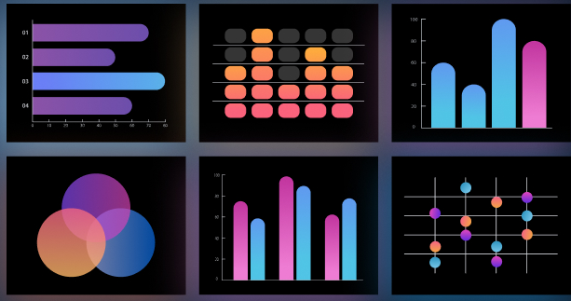
4.2 Software quality management
Testing tools like Selenium and JUnit, CI/CD tools like Jenkins, and QA management platforms such as Jira and TestRail are commonly used to facilitate quality control and assurance activities.

Slide 19
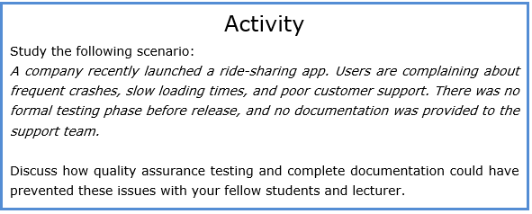
4.2 Software quality management

Slide 20
4.3 Quality management framework
As the complexity and scale of software projects increase, ensuring high quality throughout the development process and in the final product has become essential.
This is where Software Quality Management (SQM) frameworks prove invaluable.

Slide 21
4.3 Quality management framework
A SQM Framework provides a structured and methodical approach to defining, evaluating, and enhancing software quality across the software development life cycle.
It enables organisations to establish clear standards, processes, and best practices.

Slide 22
4.3 Quality management framework
Table 1 summarises the key Software Quality Management Frameworks used in many industries (Al-Daja, 2025; ASQ, 2025; Atlassian ITIL, 2025; Hayes, 2024; IEEE, 2025; ISO, 2025; Opperman, 2023; Rao, 2024; Son, 2024; and Sumrak, 2024):

Slide 23
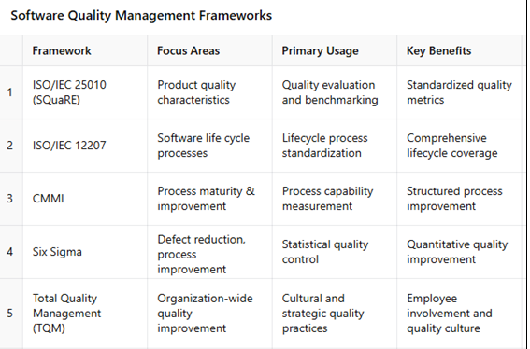
4.3 Quality management framework

Slide 24
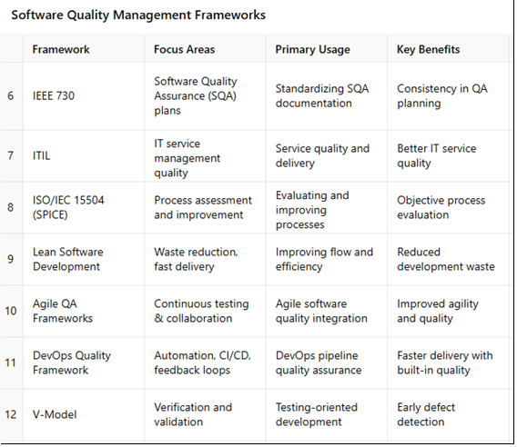
4.3 Quality management framework

Slide 25

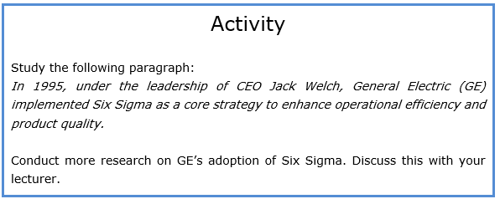
4.3 Quality management framework

Slide 26
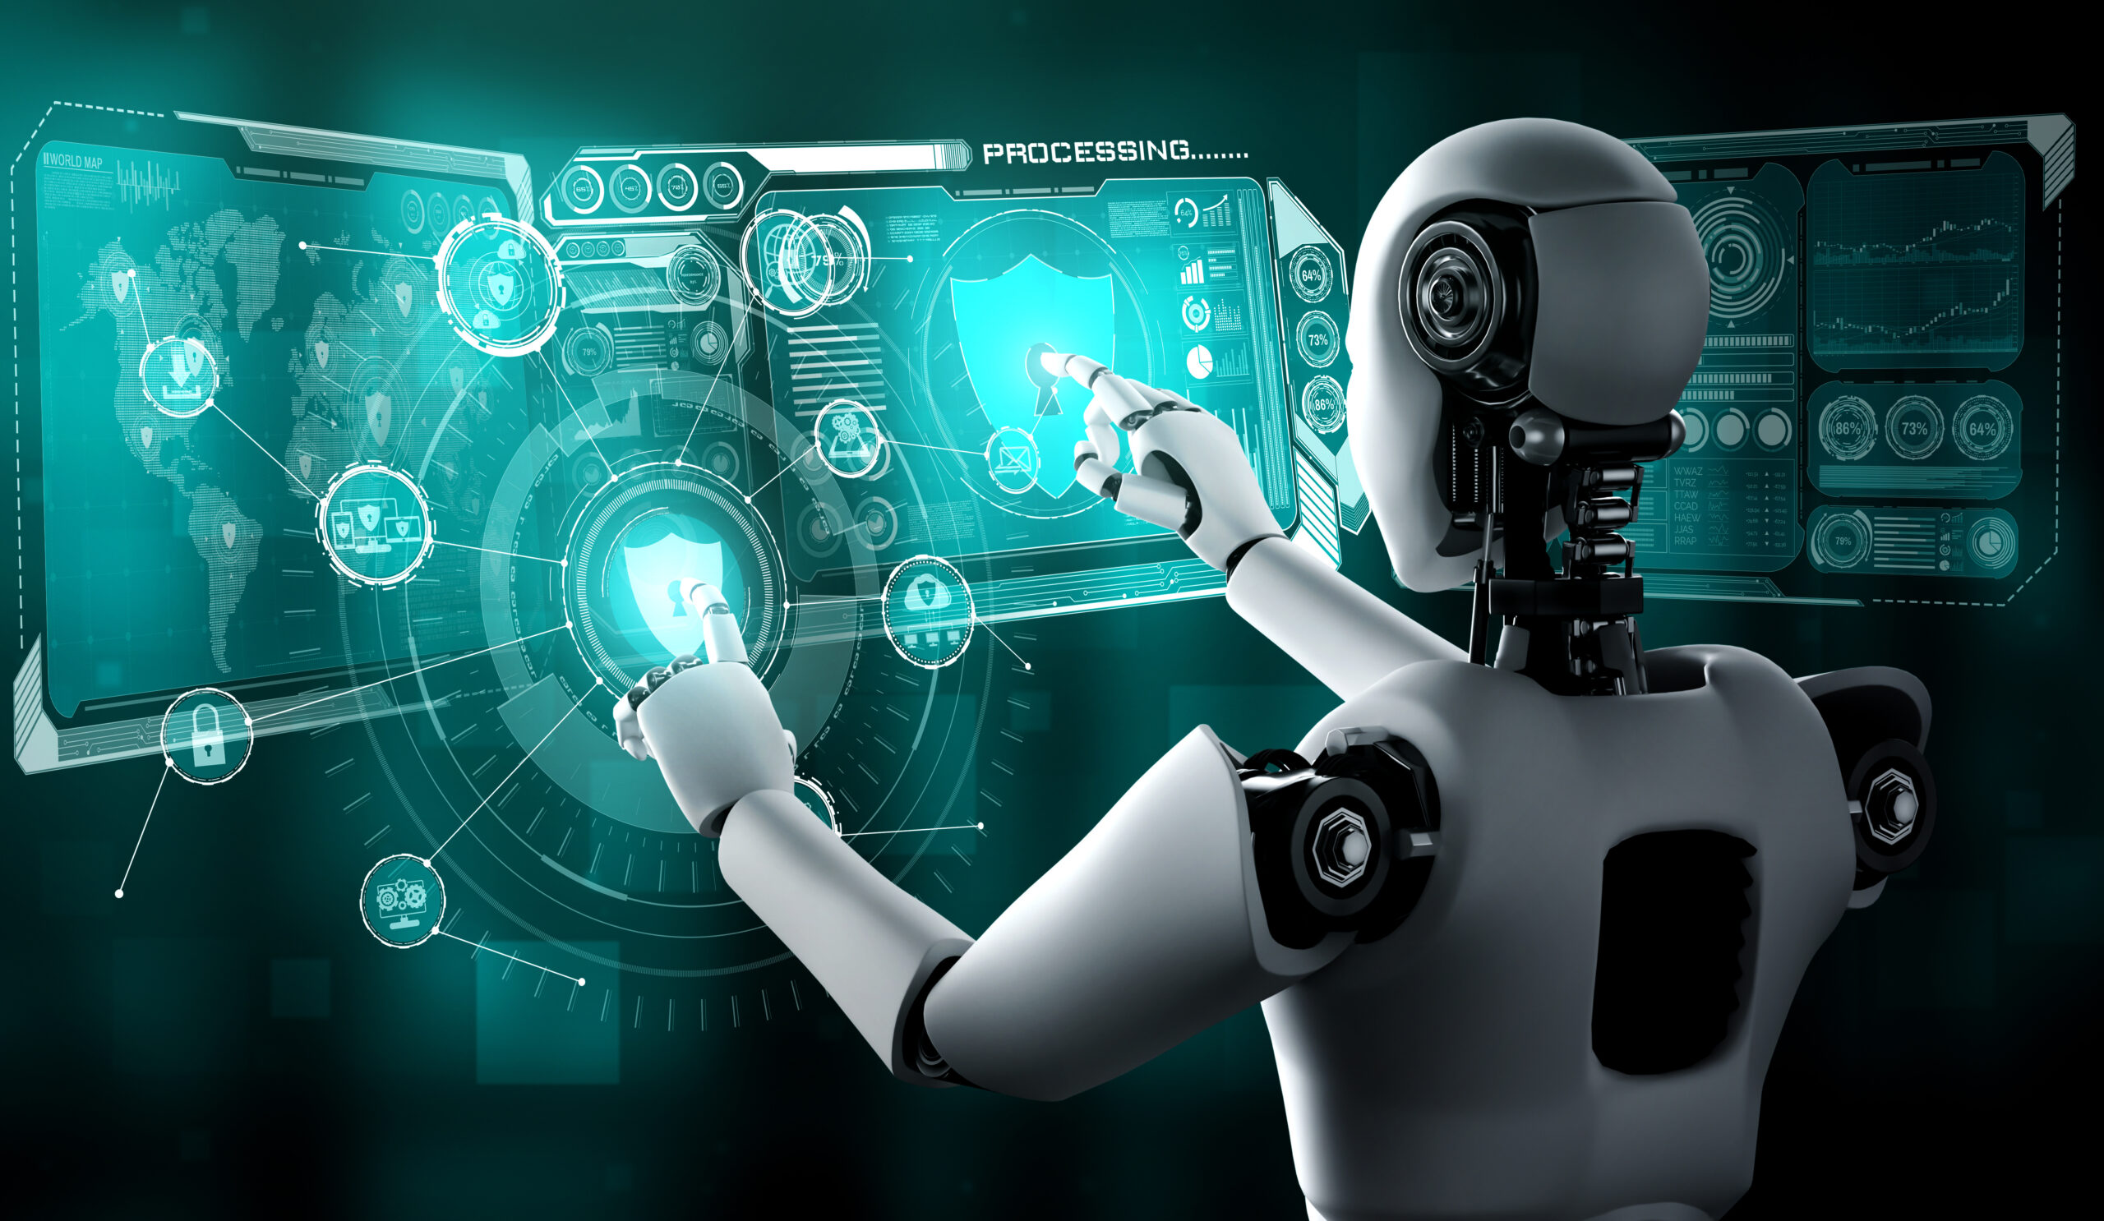
4.4 Artificial Intelligence (AI) and software development
From writing and reviewing code to automating testing and managing projects, AI is playing an important role in how modern software is built and maintained.
With continuous advancements in machine learning and natural language processing
developers now have powerful tools at their fingertips that improve productivity and accuracy, allowing them to focus on more strategic and creative aspects of their work.

Slide 27
4.4 Artificial Intelligence (AI) and software development
One of the most visible impacts of AI in software development is in code generation and completion.
AI can also support the testing phase by automatically generating test cases, identifying bugs, and recommending fixes.
Debugging, a traditionally time-consuming process, is also becoming more streamlined thanks to AI.

Slide 28
4.4 Artificial Intelligence (AI) and software development
An important benefit of AI in software development is the rise of natural language interfaces.
AI models can carry biases from the data they’re trained on, potentially leading to flawed outputs.
There are concerns about security and intellectual property when using AI-generated code.

Slide 29
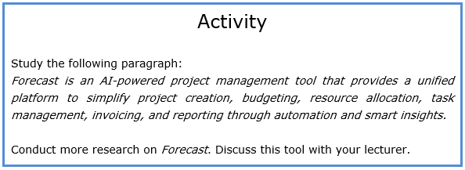

4.4 Artificial Intelligence (AI) and software development

